Slide 1
IOD Capstone Project
Sentiment Analysis of Amazon Unlocked Mobile Phones Dataset.
Lachlan Links

Slide 2
Introduction
About Me
Lachlan Links
24 year old graduate
Background in Psychological Science (Griffith University)
Agenda
Topic Introduction
Dataset Description
Insights and EDA
Modelling
Predictions
Conclusion

Slide 3
Project introduction
What the dataset is about?
This is a large dataset of a collection of unlocked mobile phones from different brands sold on Amazon.
Amazon is one of the largest online shopping platforms which can be accessed worldwide.
Why is this dataset important?
Mobile phones are a product used by majority of the population daily, making this a largely purchased product.
Amazon is one of the main places where people can purchase phones.
Reviews are left for each phone in written form and rating form, these reviews can affect the sale of the phone significantly.
Business questions
Explore top brands of phones and their ratings.
Break down the written reviews and be able to predict the outcome of a review (positive/negative and rating 1-5)

Slide 4

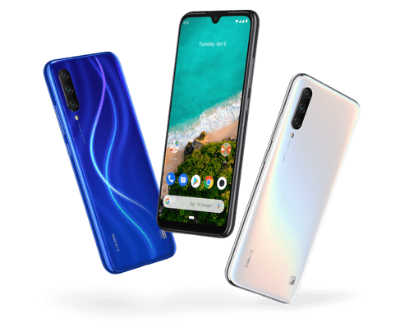
About the dataset
Dataset is a collection of reviews of unlocked mobile phones of Amazon.
Reviews consist of price, brand, phone name, written review and rating.
Dataset has 413840 review entries.
Dataset contains a varying number of types of phones and review ratings.

Slide 5
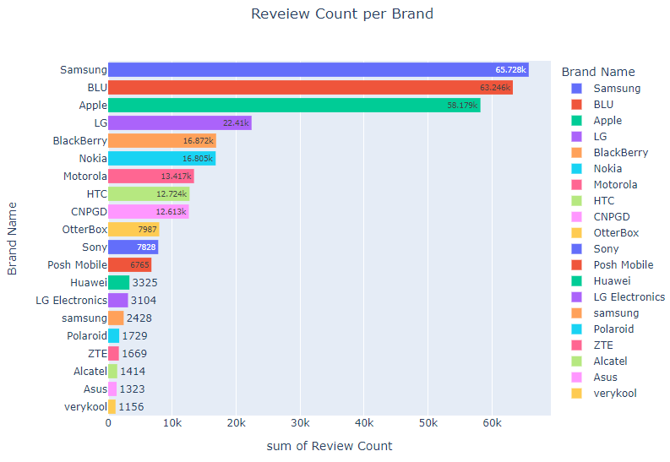
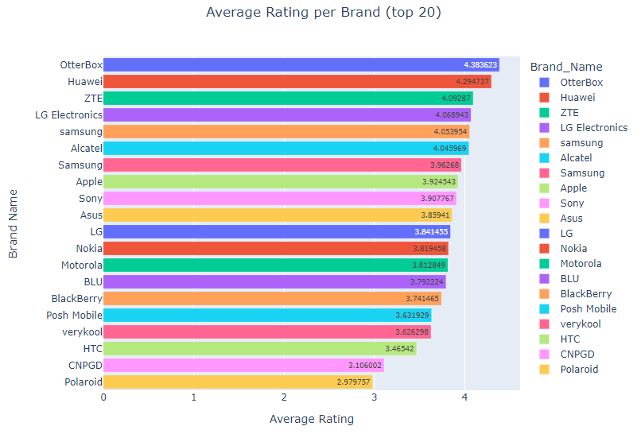
Top Brands and Reviews
-1
-3
-2

Slide 6
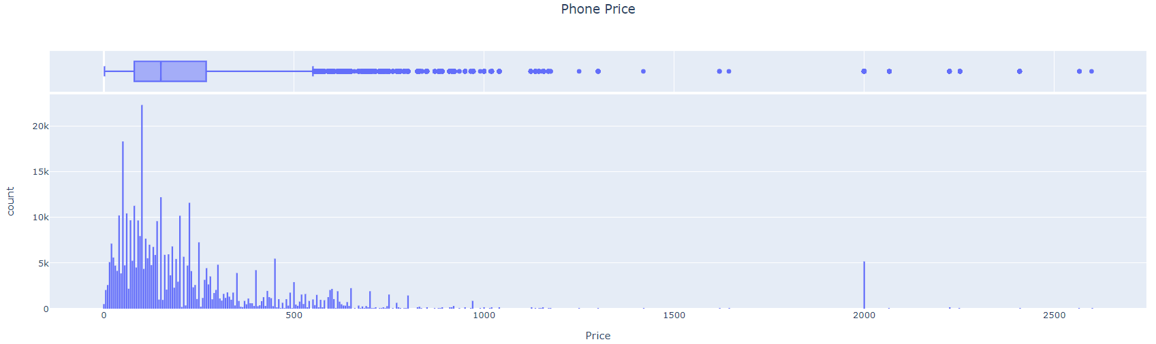
Price
Mean Price: $226.86. Standard Deviation: $271.05. Price Correlation with Rating: 0.07.
Price is positively skewed with most phones being at the lower price range.
There were quite a few outliers (expensive phones), these were kept in since price wasn't the target variable. Price had a small correlation with ratings.

Slide 7
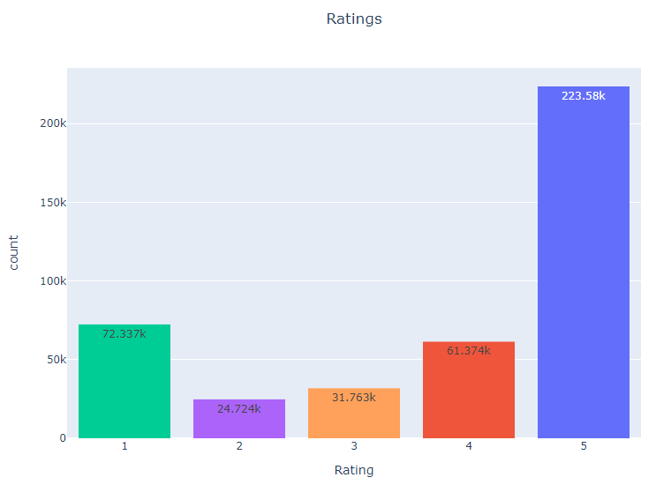
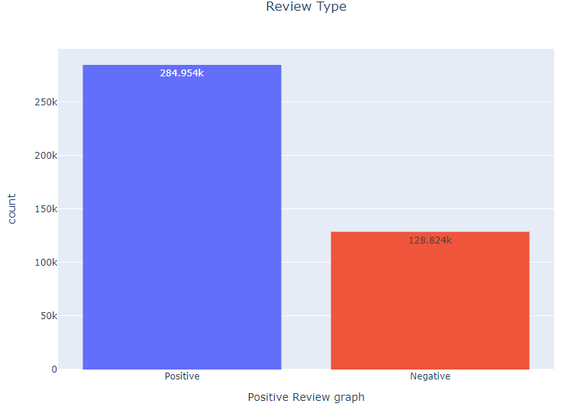
Review Breakdown
Positive review = rating >=4
Negative rating = rating >=3
Positive reviews outway negative. Mostly high (5 star) reviews

Slide 8
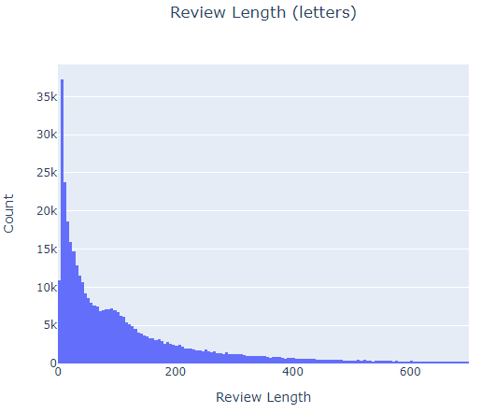
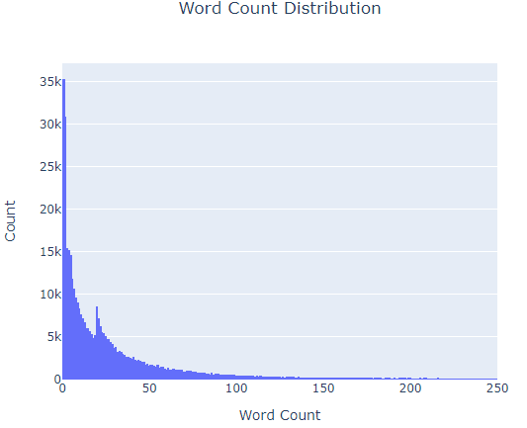
Written Review Breakdown
Review length mean : 177
Review length sum : 73,327,120
Word count mean : 40
Word count sum : 16,754,756

Slide 9
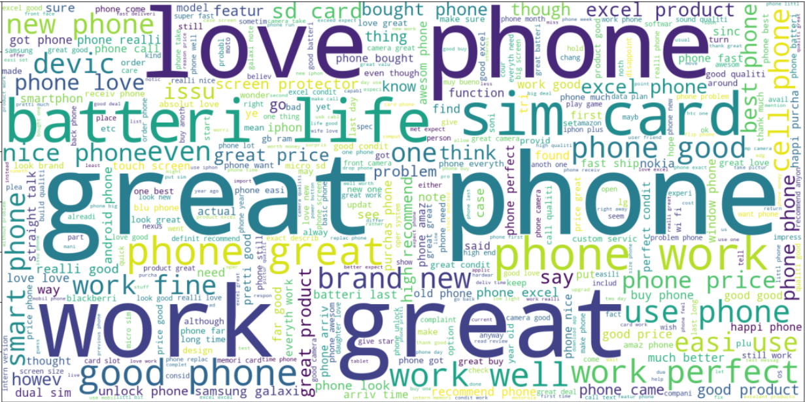
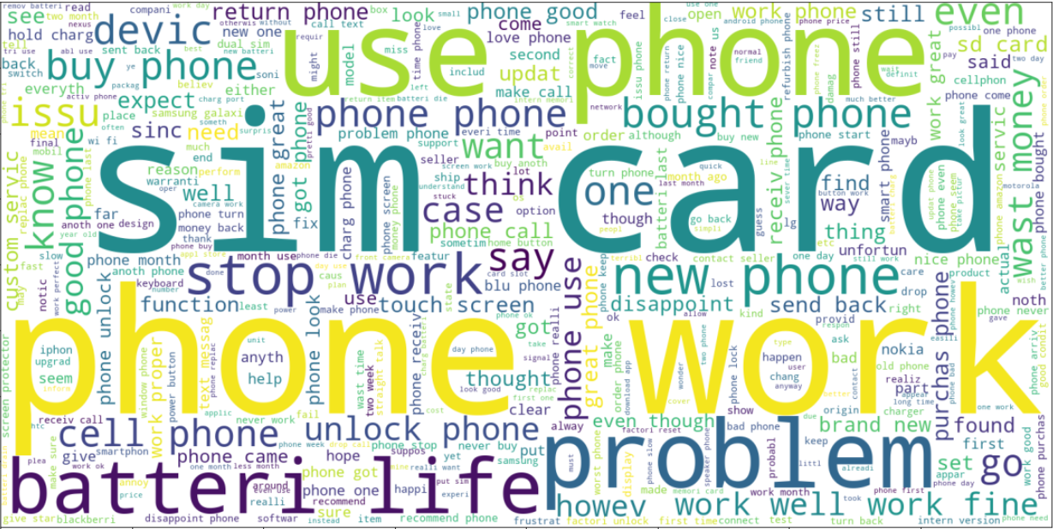
Word Clouds
Positive Review
Negative Review
Key Positive Words:
Great, work, well, perfect, good, love, best, really good, work perfect.
Key Negative Words:
stop work, issue, problem, send back, return phone, waste money, disappoint, money back

Slide 10
Project Pipeline
EDA / Data Cleaning and Text Preprocessing
Split data, create model design and test all models
Parameter tuning and optimization for best model
Apply model and make predictions of reviews
413778 rows after cleaning.
Stemming, tokenization, stop words and lowercasing used for text processing.
70% train 30% test. Stratify reviews due to imbalance.
Test all models on base parameters.
Grid search and cross validation and parameter turning was applied to random forest model to increase accuracy.
Apply test data to tuned model and make predictions. Test model with 3 way and 5 way review system.

Slide 11
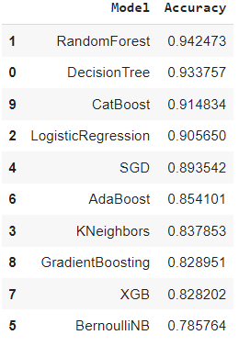
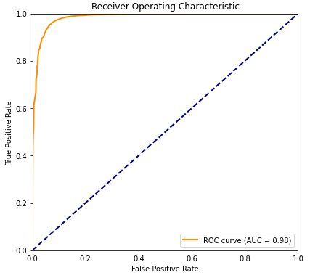
Model Performance
Performance across binary classification
Random Forest Performance after Optimization
Metrics
Accuracy | 0.952978
Precision | 0.957223
Recall | 0.975306
ROC AUC | 0.984691

Slide 12
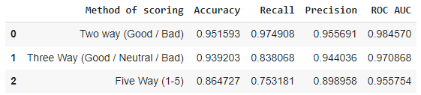
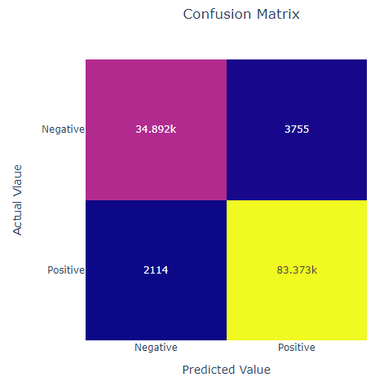
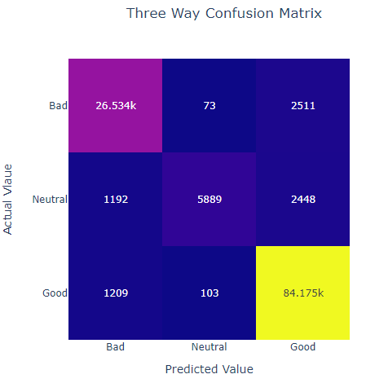
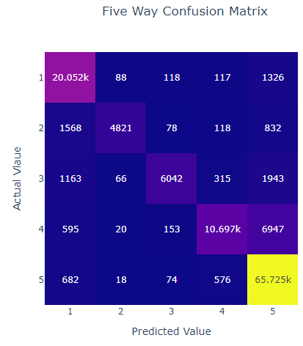
Results Across Different Scoring

Slide 13

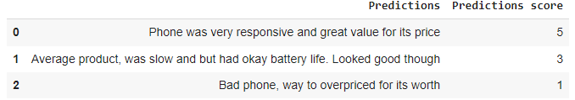
Predictions
Two Way Predictions (positive/negative)
1 = Positive
0= Negative
Five Way Predictions (1-5 rating)
Predictions Summary
Predictions created had accurate scores as intended. Two way predictions showing both a positive and negative while five way predictions showing a top, medium and low review. These were the goals for each review when created.

Slide 14
Conclusion
There are three main phone brands that take up most of the sales (Samsung, Blu and Apple). (B1)
This dataset and analysis allows for a very accurate prediction rating for phone review (0.95). (B2)
Even with a more diverse scoring system (3 way or 5 way) it still has a high accuracy of 0.93 and 0.86 respectively.
Positive and Negative word clouds allowed for a descriptive breakdown of what words/phrases are involved in each type of review.
Written review predictions were made and scored accurately by the model. This allows for score predictions on future phone reviews.
Further developments could be made on this dataset by continuing to update phone reviews as new phones would be coming out with different features which may not be mentioned in older reviews.

